Slide 1
Stock & logistics KPIs - data sources

Slide 2
Challenge instructions:
To complete this challenge, you need to make a copy of these slides in your own Drive (File > Make a copy > Entire presentation ).
We will go through a purchase section and a logistics section. For each section, you will find 3 diagrams
representing different business models. On each diagram, you need to determine the data necessary to calculate the KPIs and
determine their position in the business chain. Write the required data sources in the orange boxes on the slides.

Slide 3
Part 1: Purchase / Procurement

Slide 4


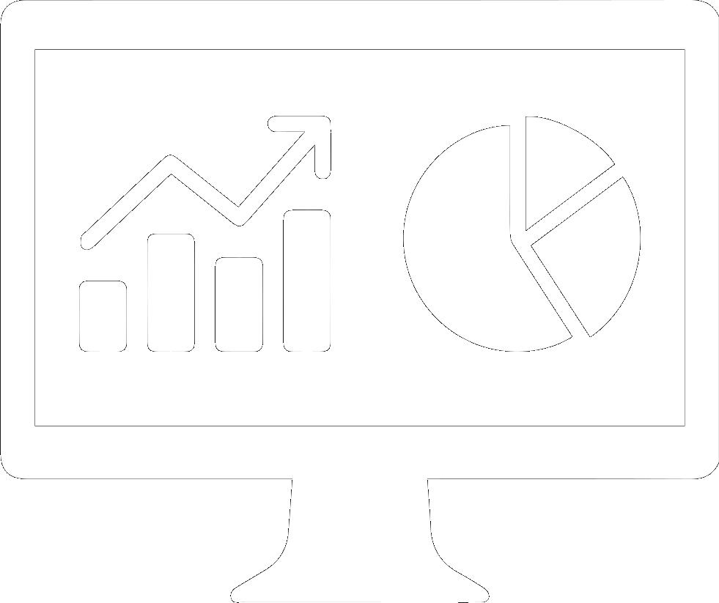




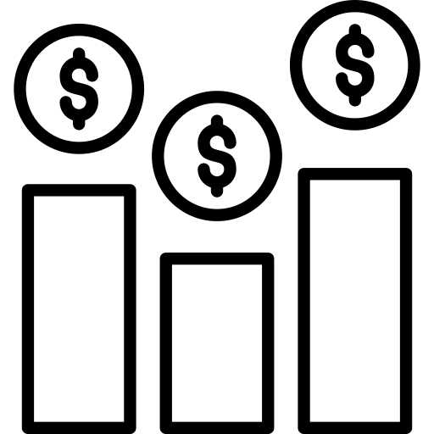

Lecture reminder: objectives for the purchasing team
Mission
Identify the right products at the best purchase price
Offer a high availability without stock shortages, nor overstock
Manage inventory & forecasts: order the right products, track supplier deliveries, track overstock and expiry dates
Identify best sellers and slow sellers to update catalog
Data use
How to measure:
KPIs
Availability
Quality
Price
Number of suppliers
Compliance
rate
Shortage rate
Customer reviews,
Sales volume
Price competitiveness, Purchase discount rate
Examples of sources
Suppliers
Purchase orders
Inventory
Customers orders
Price/Margin (competitive intelligence)

Slide 5
Lecture reminder: objectives for a marketplace model
Mission
Identify the right merchants with the right product at the right price
Manage commercial relationships with them: good price, interesting discounts, high quality of service
Manage catalog and new products
Identify the right merchants, monitor their service : product quality, shipping fees, time-to-deliver
Monitor sales and offers to detect growth potential and prevent decline in sales
Data use
How to measure:
KPIs
Availability
Quality
Price
Delivery time from merchant to end customer
Shortage rate
Merchant compliance rate,
service level
Customer satisfaction
Price competitiveness, Purchase discount rate
Examples of sources
Merchants
Customer orders
Merchants
Customers orders
Price/Margin (commission)

Slide 6

Lecture reminder: objectives for the sourcing team
Mission
Identify the right raw materials and reliable suppliers offering both quality and competitive
purchase prices.
Ensure high availability without stock shortages or emergency purchases.
Manage inventory & forecasts: order goods, track supplier delivery, track inventory and overstock
Identify the best products to answer production needs
Identify the best suppliers
Data use
How to measure:
KPIs
Availability
Quality
Price
Number of suppliers
Purchase time
Shortage rate, Emergency purchases
Compliance rate,
Defect rate
Price competitiveness, cost-saving
Examples of sources
Suppliers
Purchase orders
Customer orders
Inventory
Price/Margin (competitive intelligence)

Slide 7
Purchase / procurement
Let's focus on inventory management, which is one of the first areas where data is utilized.
🎯 The goal is to monitor stock levels in order to prevent shortages and to procure the right products from suppliers at the right time. It is crucial to forecast future sales to ensure the availability of required inventory without excessive overstocking.
For each of the following business models, identify the stages (highlighted in green boxes) in the business value chain that the procurement team should concentrate on for their analysis. Additionally, for each stage, provide a list of possible associated data (highlighted in orange boxes).

Slide 8











E-commerce Model
Ads
Mail
Supply
Payment
Refunds
Activity model
Traffic
User
Products
Order
Shipping
Customers
relation
Data
Media
CRM
Marketing (com’, pricing and commercial animation)
Operation team (logistic and shipping)
Service
IT
Traffic Management
Purchase / Marketplace
Finance
Customer service
Ads campaigns reporting
Customers base animation
Business activity monitoring
Delivery tracking
Use Case
Traffic optimisation
Inventory / merchants management
Financial profitability reports
Customers satisfaction analysis

Slide 9






Industry Model
R&D
Recruitment
Ads
Payment
Mail
Activity model
Supply
Production
Sales
Client
Customer relation
Data
Research & Development
Human resources
Finance
Customer success/care
Service
Purchase
Operation team
Media
Sales
Predictive maintenance
Capacity planning
Campaign optimisation
FInancial management
Customers satisfaction monitoring
Use Case
Inventory management
Production reporting
Lead funnel monitoring

Slide 10


SaaS Model - Saas KPI + Saas bis & B2B sales
Page response time
Product bugs, Team velocity, Support ticket
Ads cost
Revenue
Sent, Click, Open, Conv’, Unsubscribe
Tech
Ads
Payment
Mail
Activity model
Product
Sales
Client
Customer support
No purchase/supply team:
For SaaS activities, a procurement team is not necessary. The software itself is the product, so there is no need for raw material procurement.
Data
Onboarding rate, usage, adoption, engagement, Time to value
Revenue, Wage cost
Client, Churn, Segment, New, Cohorte
Customer Retention Rate
Churn rate, NPS, upsell
IT
Media
Finance
Customer care/success
Service
Product
Sales
CRM
Campaign optimisation
FInancial management
Customers satisfaction monitoring
Use Case
Traffic analysis and product optimisation
Lead funnel monitoring
Customers base animation

Slide 11
Part 2: Logistic and Shipping

Slide 12

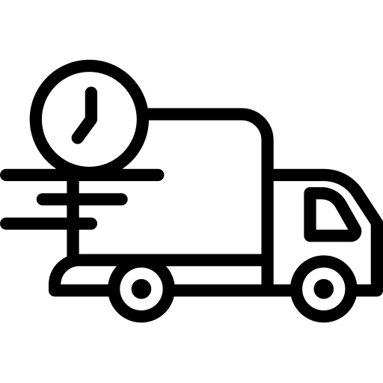


Lecture reminder: objectives of the logistics (shipping & transport) team
Mission
Ensure a quick preparation and delivery of products
Limit delays, defective or missing products
Monitor preparation of parcels, inventory and shipping
Control delays, defect or missing rate
Data use
How to measure:
KPIs
List of parcels
Shipping time
Delivery time
Error rate:
delays, missing, defective, lost or wrong product
Examples of sources
Customer orders
Warehouse
Shipping
Client issues/ refunds

Slide 13
Logistic and shipping
Let's focus on the primary use of data in this context, which is tracking deliveries and managing outstanding parcels.
🎯 The objective is to monitor order shipments to customers, identify and prevent issues, and uncover optimization opportunities. The team also needs to handle incoming orders upstream and address customer inquiries regarding delivery problems downstream.
For each of the following business models, identify the stages (highlighted in green boxes) in the business value chain that the procurement team should concentrate on for their analysis. Additionally, for each stage, provide a list of possible associated data (highlighted in orange boxes).

Slide 14
E-commerce Model
Ads
Mail
Supply
Payment
Refunds
Activity model
Traffic
User
Products
Order
Shipping
Customers
relation
Data
Media
CRM
Marketing (com’, pricing and commercial animation)
Operation team (logistic and shipping)
Service
IT
Traffic Management
Purchase
Finance
Customer service
Ads campaigns reporting
Customers base animation
Business activity monitoring
Delivery tracking
Use Case
Traffic optimisation
Inventory management
Financial profitability reports
Customers satisfaction analysis

Slide 15
Industry Model
R&D
Recruitment
Ads
Payment
Mail
Activity model
Supply
Production
Sales
Client
Customer relation
Data
Research & Development
Human resources
Finance
Customer success/care
Service
Purchase
Operation team
Operation team
Media
Sales
Predictive maintenance
Capacity planning
Campaign optimisation
FInancial management
Customers satisfaction monitoring
Use Case
Delivery tracking
Production reporting
Lead funnel monitoring
In the industrial sector, the supply team must track the delivery of orders from suppliers to the company's warehouse before production can commence. They also need to monitor product delivery to customers after production is complete. Depending on the company's growth, different teams may handle these tasks. In the diagram below, we assume that the supply team is responsible for both.

Slide 16
SaaS Model - Saas KPI + Saas bis & B2B sales
Page response time
Product bugs, Team velocity, Support ticket
Ads cost
Revenue
Sent, Click, Open, Conv’, Unsubscribe
Tech
Ads
Payment
Mail
Activity model
Product
Sales
Client
Customer relation
No logistic/shipping team:
For SaaS activities, a logistics & shipping team is not required. Since the product sold is software, there is no physical delivery to customers.
Data
Onboarding rate, usage, adoption, engagement, Time to value
Revenue, Wage cost
Client, Churn, Segment, New, Cohorte
Customer Retention Rate
Churn rate, NPS, upsell
IT
Media
Finance
Customer care/success
Service
Product
Sales
CRM
Campaign optimisation
FInancial management
Customers satisfaction monitoring
Use Case
Traffic analysis and product optimisation
Lead funnel monitoring
Customers base animation

